Slide 1
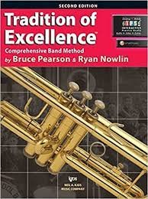
Join Band!
You will need the following Items:
An instrument
Supplies (depends on the instrument you choose)
A music book – TRADITION OF EXCELLENCE for your instrument
One inch binder and pencil
With Mrs. Bell.
Turn in a BAND REGISTRATION to your classroom teacher or the office

Slide 2
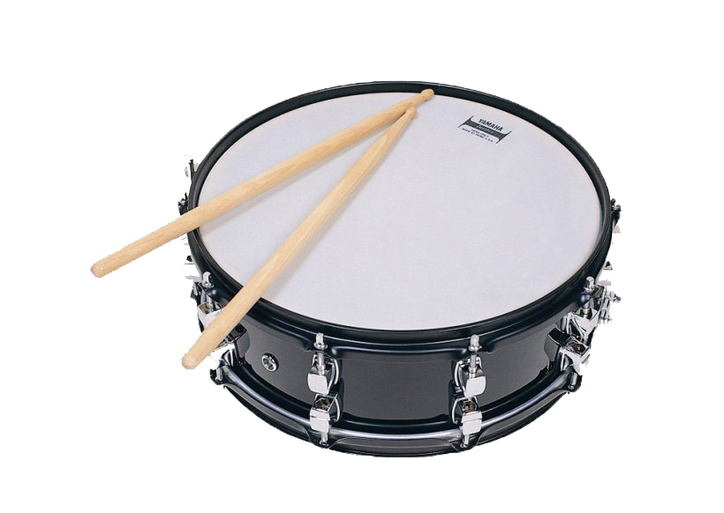
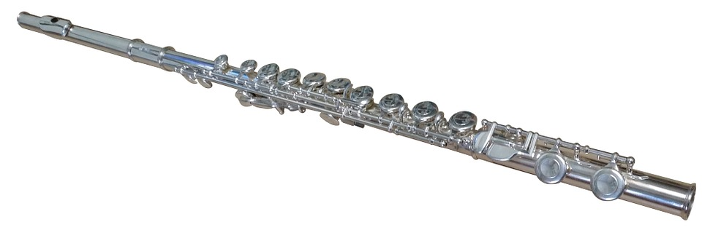
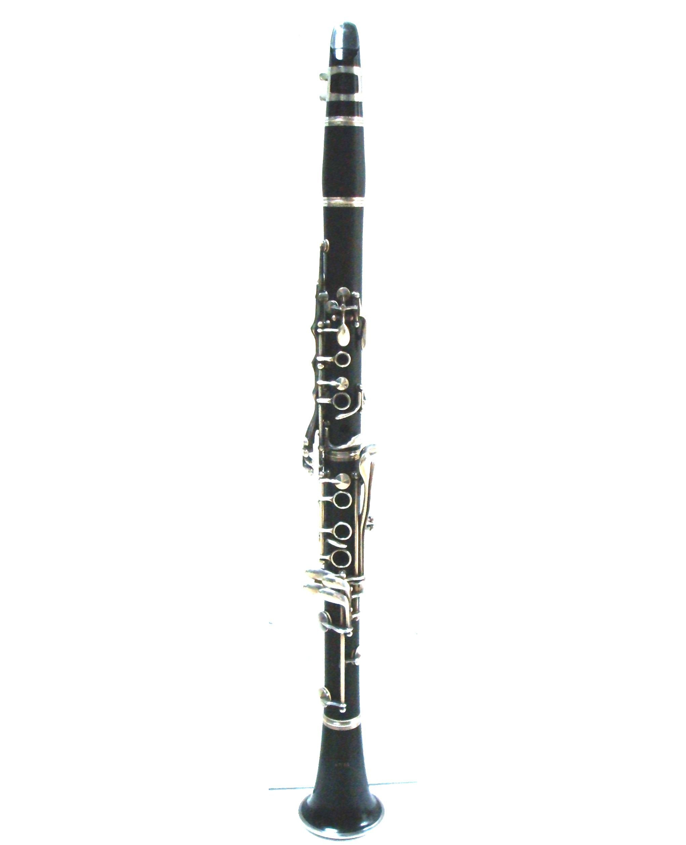
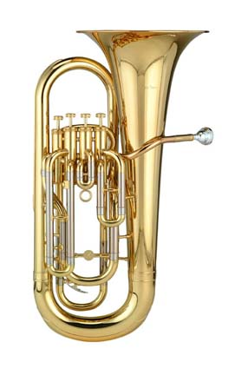
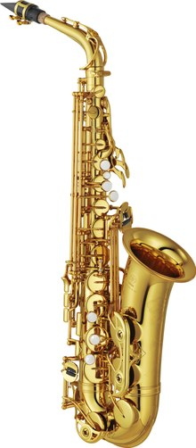
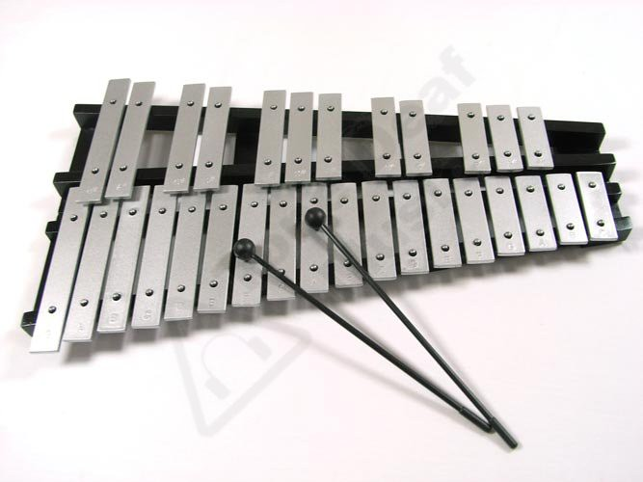
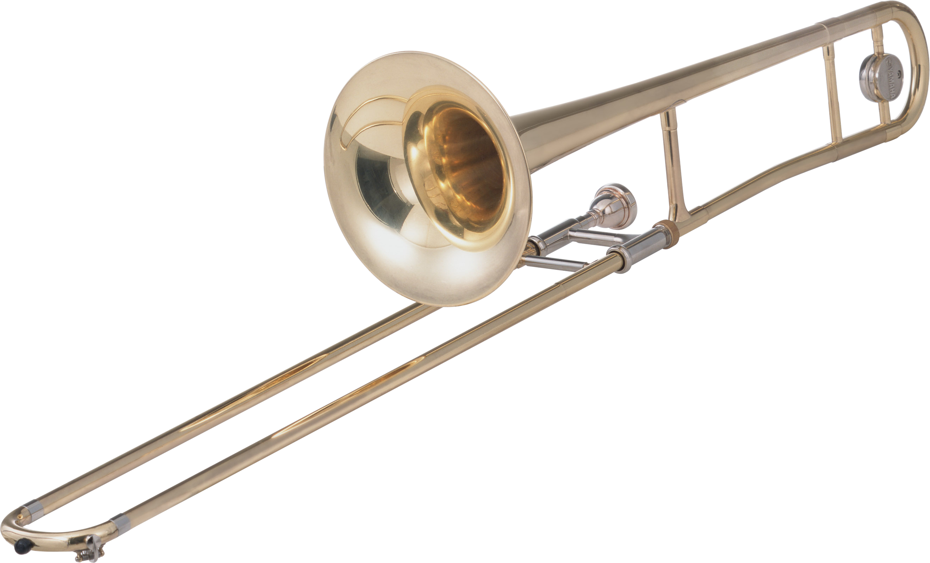
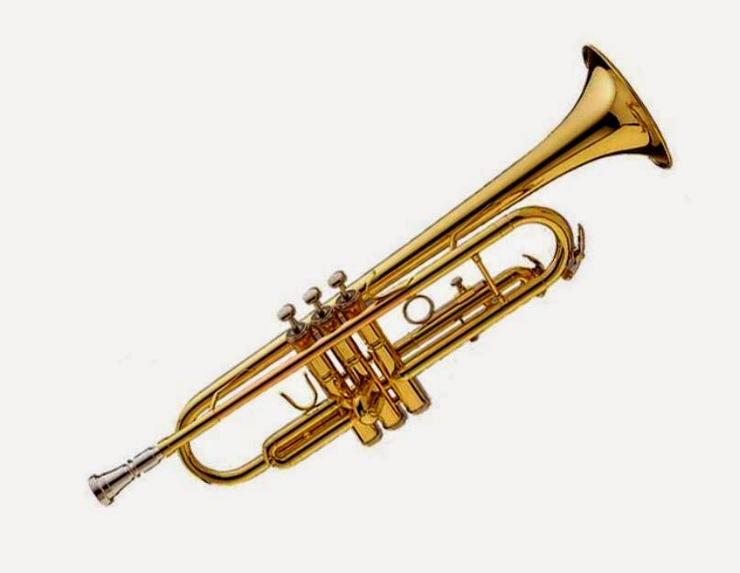
Commit to Learning AN INSTRUMENT
Choose your instruments
Check with parents to see about using a family instrument, renting or purchasing an instrument.
A few instruments are available on loan from the district for students who qualify.
This Photo by Unknown author is licensed under CC BY-NC.
This Photo by Unknown author is licensed under CC BY.
This Photo by Unknown author is licensed unr CC -SA-NC.
This Photo by Unknown author is licensed under CC BY-SA.

Slide 3
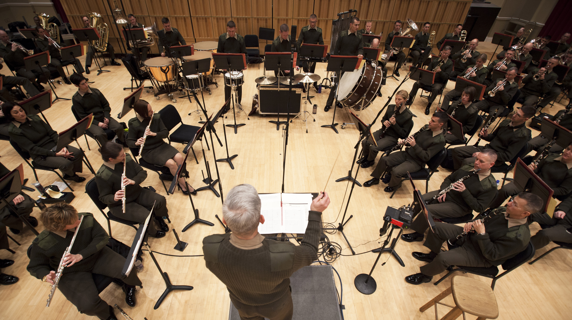
Attend All Rehearsals
We will be working in small groups.
Woodwinds-clarinets/saxes/flutes
Brass-trumpets/trombones/baritones
Percussion (Bells and drums)
You are responsible for making up any work you miss in class when you are in band rehearsal.
Come with all of your supplies ready to learn and have fun!
This Photo by Unknown author is licensed under CC BY-SA.

Slide 4
Practice and prepare
Practice will be at least 15 minutes per day five days a week

Slide 5
Chino Valley Unified School District
Band Registration Information
Welcome back to a new school year! I am excited that your child has expressed an interest in the CVUSD band program!
CVUSD offers students in grades 5 and 6 the opportunity to learn one of the following instruments:
FLUTE CLARINET SAXOPHONE
TRUMPET BARITONE TROMBONE
PERCUSSION (drum kit needed and includes bell set and drum pad)
The district does not provide band instruments for student use, although one may be available to borrow (at no cost) through the district’s loaner program. Forms for this program are in the office and need to be returned as soon as possible. This program is based on financial need. Otherwise, parents are responsible for purchasing or renting an instrument if one is not available to borrow from friends or family.
Loan application forms will be available in the School Office.
(Please do not purchase an instrument from a warehouse, toy, or discount department store. Although the low price is attractive, they are very low quality and will create a frustrating playing experience for your child!)
In addition to an instrument, STUDENTS need to purchase the following supplies:
Method book: Tradition of Excellence, book 1 for your instrument, a small 3-ring binder, ten page protectors, luggage tag and a pencil
*Clarinet and Sax players only: 5 reeds, size 1 1/2 (as they break, they will need replacements during the school year), cleaner, cork grease
*Trumpet players: valve oil, old wash cloth
*Trombone players: slide grease, old wash cloth
*Flute players: cleaning rod and cloth
*Percussion players: drum kit (includes bells, drum pad and sticks/mallets)
Supplies can be purchased through amazon or local music stores (ex. Sam Ash, Guitar Center, Gards, KYR, Music and Arts etc.)
Students will be provided specialized instrument masks for their use in band.

Slide 6
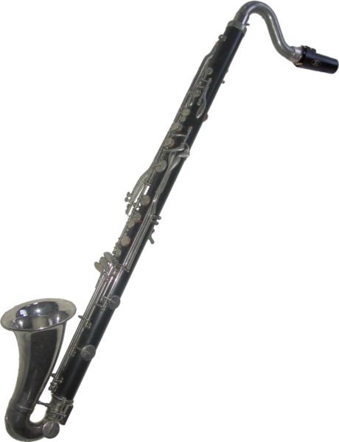
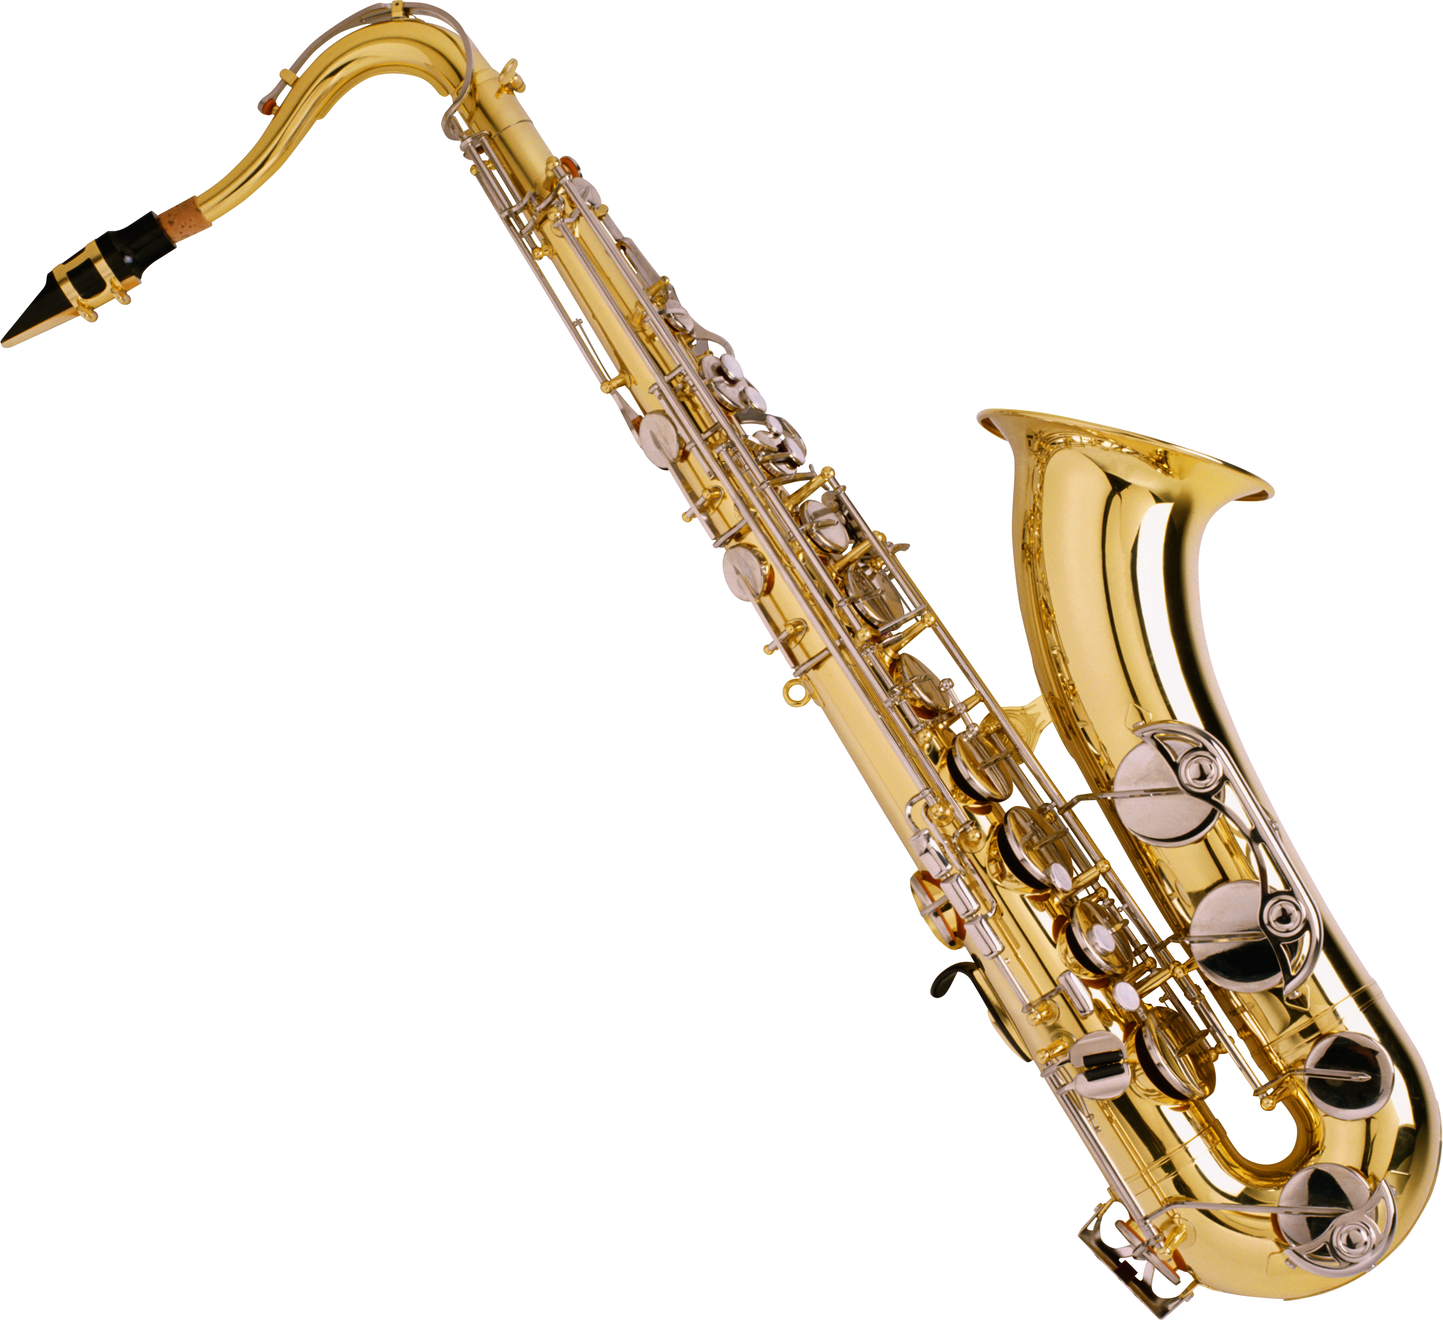
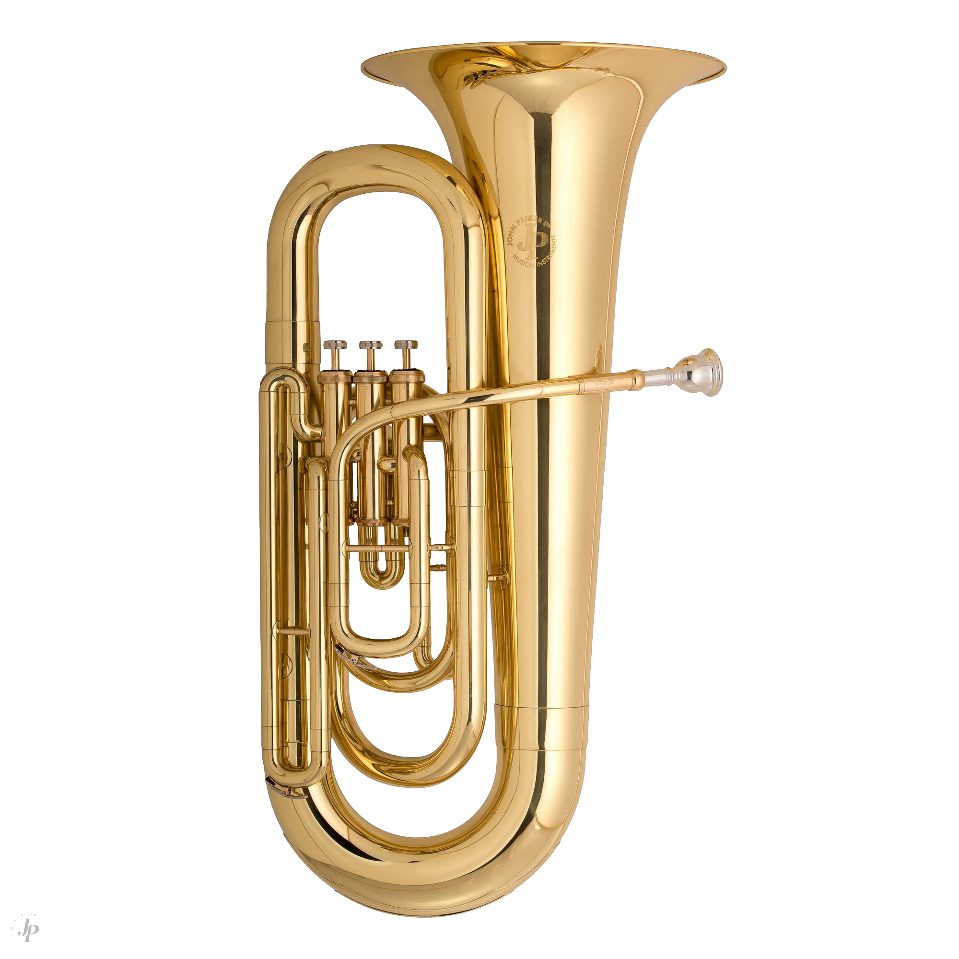
To make a full band we need...
4
8
8
2
12
2
6
This Photo by Unknown author is licensed under CC BY-NC.
8
6

Slide 7
Questions?
Email Pam_Bell@chino.k12.ca.us
Coming Soon!
More information will soon be posted on my webpage
This Photo by Unknown author is licensed under CC BY-SA.

